Slide 1
Counting-Mechanic-Documentation

Slide 2
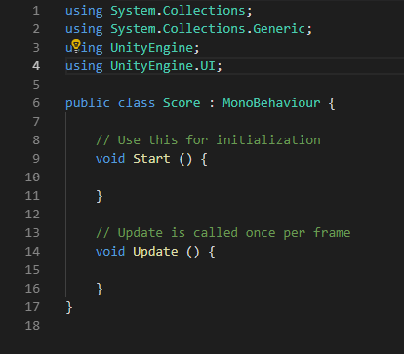
Phase:1
When creating the script I first started by adding “Using UnityEngine.UI;”.
This was so I could make my script interact with the UI in the scene.

Slide 3
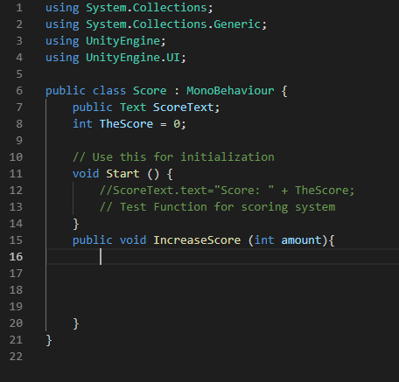
Phase:2
I then got rid of the “void Update” as I no longer needed to have it in the script.
I then added two new variables, the variables are called “ScoreText” & “TheScore”. I have made one of them public so that I can interact with it on the scene.
After creating the variables I then made a new void of my own called “IncreaseScore”.

Slide 4
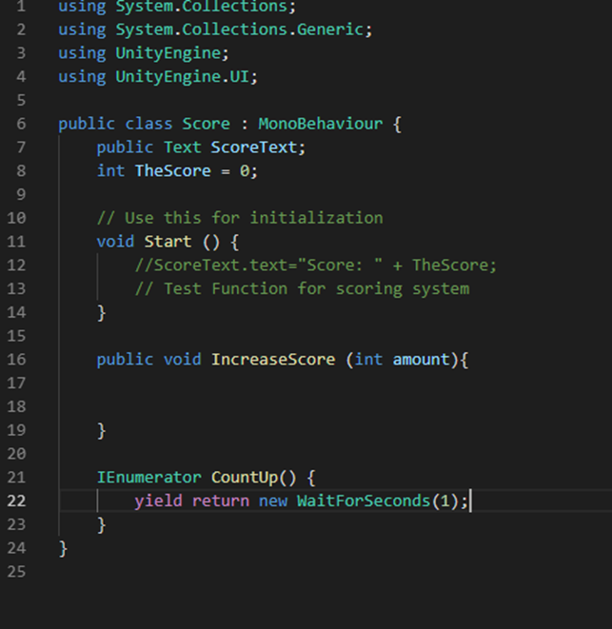
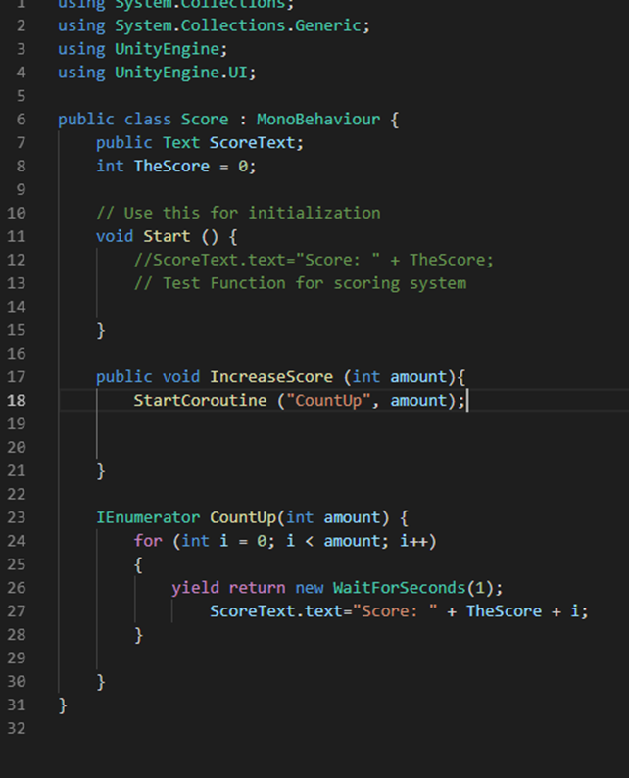
Phase:3
I then began to add a counting function which would count up in units of 1. By creating a coroutine function.
I then made the coroutine count up in units of one per second.

Slide 5
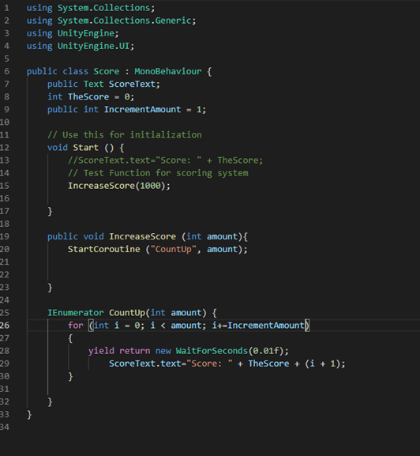
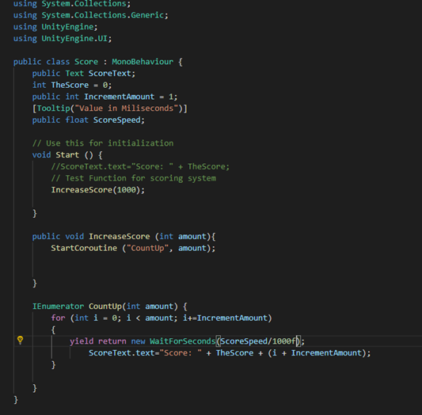
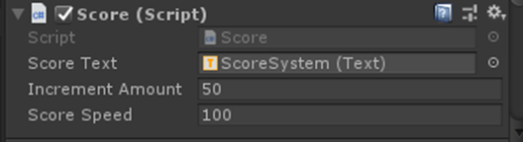
Phase:4
I then added in a function that would enable me to edit the amount it would increase by per second within Unity.
I then created a variable for the speed that I could control also within Unity.
This is an image of the function that enables me to edit its speed and the increase amount working in Unity.

Slide 6
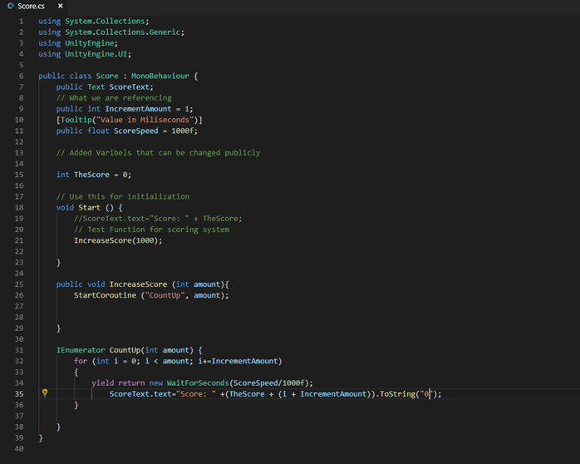
Phase: Bonus
I as an extra precaution added a to string function, just as a failsafe.

